Slide 1
ELECTRICAL SCIENCE-1
(15B11EC111)
Unit-4
Sinusoidal Steady State Analysis
( Physical Model for a Sinusoid, Average Value, Effective Value, Phasor presentation, Addition of Phasor using Complex Numbers, Concepts of impedance and admittance. )
Lecture-1
Dr. Abhishek Kashyap
Assistant Professor (Senior Grade, JIIT Noida)

Slide 2
Topics to be covered
DC and AC Currents.
A Sinusoid.
❑ Some Definitions.
❑ Phase Difference.
❑ Physical Model for a Sinusoid.
Average of a sine wave.
RMS or Effective Value.
Concept of Phasors.
❑ Operations on Phasors.
Additions of Phasors
Using Complex Numbers.
Power and Power Factor.
Purely Resistive Circuit.
Purely Inductive Circuit.
❑ Inductive Reactance.
Purely Capacitive Circuit.
❑ Capacitive Reactance
2

Slide 3
DC and AC Currents
Difference between
In dc circuits, when a current of 3 A adds to another current of 4 A, the net current is always 7 A.
However, an ac current of 3 A when added to another ac current of 4 A can result anything between 1 A and 7 A, depending upon their relative phase.
It is similar to adding a force of 3 N to another force of 4 N. The result is not necessarily a force of 7 N. It be anything between 1 N to 7 N, depending on their relative directions. These are added vectorially.
3

Slide 4
Does it mean that KCL does not apply to AC Circuits ?
Ans. :Yes, it does apply. However, the ac currents are added in a Phasor Diagram.
I = I1 + I 2
4

Slide 5
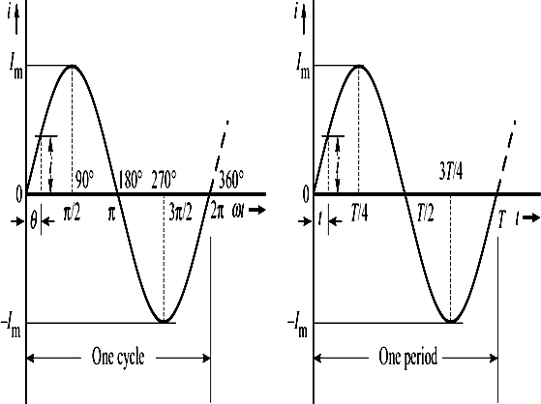
A Sinusoid
(a) Current i versus angle ωt. (b) Current i versus time t.
i = I_{m} sinωt
5

Slide 6
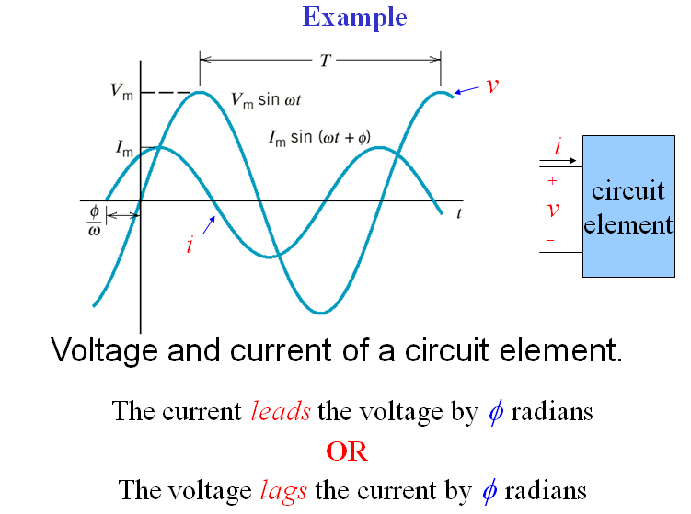

Slide 7
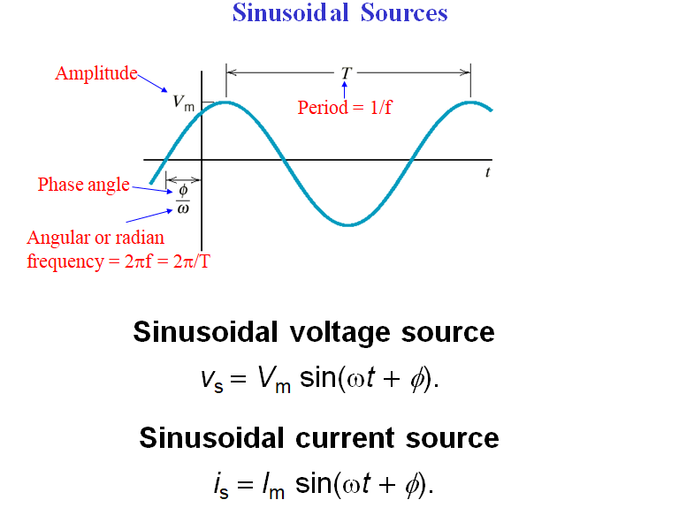

Slide 8
Some Definitions
Amplitude (or peak value) : It is the maximum value, positive or negative, of an alternating quantity.
Instantaneous Value : It is the value of the quantity at any instant.
Time period (T) : It is the duration of one complete cycle.
Frequency (f) : It is the number of cycles that occurs in one second.
f = ¹
T

Slide 9
Angular Frequency : Angular frequency, denoted as ω, is equal to the number of radians covered in one second. Its unit is rad/s. Since one cycle covers 2π radians and there are f cycles in one second, the angular frequency is given as
_{ω =} 2π
ω = 2πf
or
T

Slide 10
Phase : It is the fraction of the time-period or cycle that has elapsed since it last passed from the chosen zero position or origin. The phase at time t from the chosen origin is given by t/T.
Phase angle : It is the equivalent of phase expressed in radians or degrees. It is denoted as θ. Thus, phase angle, θ = 2πt/T.
Phase difference : It is the angular displacement between two alternating quantities.
10

Slide 11
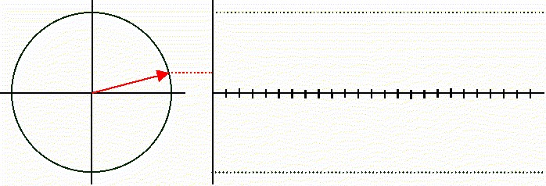
A rotating bar generates a sinusoidal wave.
11

Slide 12
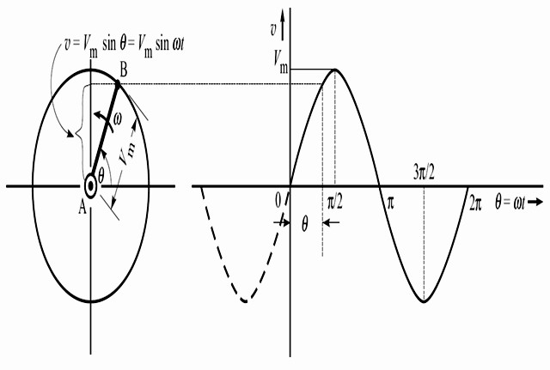
Physical Model for a Sinusoid
(a) A rotating crank. (b) Sinusoidal waveform.
The vertical projection of the rotating crank is its length times the sine of the angle θ.
12

Slide 13
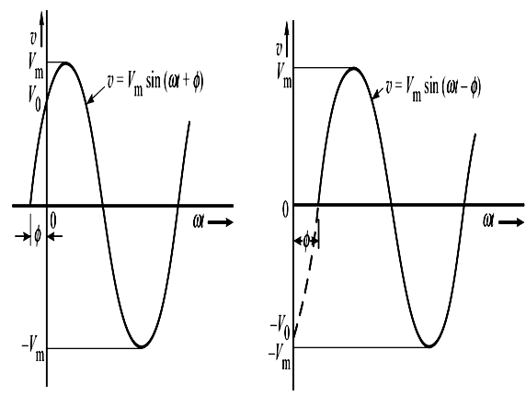
Phase Difference
(a) Displacement byφ to the left
(b) Displacement by φ
to the right
It has become normal practice in electrical engineering to express ωt in radians and the angle in degrees.

Slide 14
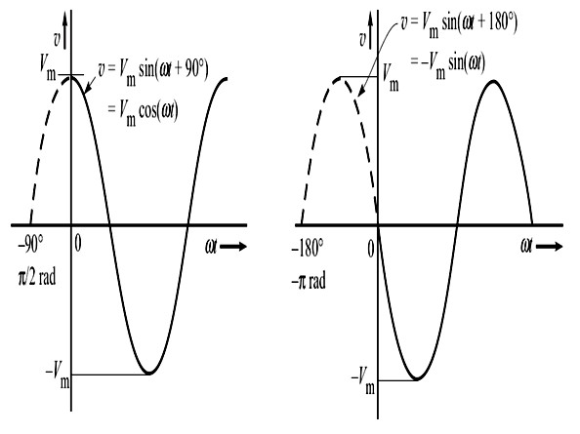
(c) Displacement
by 90° to the left.
(d) Displacement
by 180°.
Note that the resulting position of the waveform is the same whether the phase shift is 180° (π rad) to the left, or 180° to the right.

Slide 15
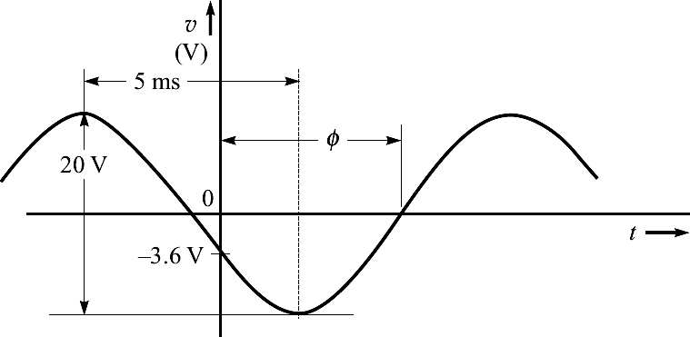
Example 1
A sinusoidal voltage is 20 V peak-to-peak, has a time of 5 ms between consecutive peak and trough, and at t = 0 is -3.6 V and decreasing. Find the equation for the instantaneous value of the voltage, and the value
of the voltage at t = 12 ms.
NOTE : First draw the waveshape, then start the solution.

Slide 16
Solution :
₌ ^{V}p− p
V
= ²⁰ 10 V;
T = 2× 5 ms = 10 ms;
m
2
2
1
1
10 ×10⁻³
∴ f = ¹ =
=
= 100 Hz
T 10 ms
∴ ω = 2πf = 2π×100 = 628.3 rad/s.
Therefore, the sinusoid voltage is of the form
v = 10sin(628.3t +φ) V
Now, we are given that at t = 0, v = -3.6 V. Putting these values, we get

Slide 17
or sinφ = −0.36 or 338.9°
− 3.6 = 10sin(φ)
⇒ φ = −158.9°
As shown in figure, the given sinusoid is shifted to
right by angle φ, which is less than 180°.
Also, we know that shifting rightward means there is a lag of angle φ. Therefore, the equation of the given sinusoidal voltage is
v =10sin(628.3t −158.9°) V

Slide 18
The value of voltage at 12 ms,
v(t = 0.012s) = 10sin ⎛ 628.3× 0.012 × ^{180°} −158.9°⎞V
⎜ ⎟
⎝
π
⎠
= 10sin (432° −158.9°) V = −9.985 V

Slide 19
Thanks

